Slide 1
THE SPARC ARCHITECTURE
Presented By
Suryakant Bhandare
ELEC 6200-001 Computer Architecture and Design Fall 2009
srb0012@auburn.edu

Slide 2
Outline
INTRODUCTION
DESIGN GOALS
HISTORY
THE SPARC ARCHITECTURE
-Integer Unit (IU)
-The Register Window
-Floating Point Unit (FPU)
-Coprocessor
INSTRUCTIONS
SPARC V9 FEATURES
REFERENCES

Slide 3
Introduction
SPARC stands for Scalable Processor Architecture.
developed by Sun Microsystems in the 1980s.
is based on the RISC structure designed at the University of California at Berkeley in early 1980s.
The SPARC architecture is a non-proprietary architecture that any person or company can license and use to develop microprocessors and other semiconductor devices based on published industry standards.
In 1989, Sun Microsystems transferred ownership of the SPARC specifications to an independent, non-profit organization, SPARC International, which administers and licenses the technology and provides conformance testing and other services for its members.

Slide 4
Design Goals
SPARC was designed as a target for optimizing compilers and easily pipelined hardware implementations. SPARC implementations provide exceptionally high execution rates(MIPS) and short time-to-market development schedules.
Provide the scalability of the cost/performance ratio of successive implementations with the current improvements in circuit technology.
The "Scalable" in SPARC comes from the fact that the SPARC specification allows implementations to scale from processors required in embedded systems to processors used for servers.

Slide 5
Brief History
3 major revisions to the SPARC architecture
- SPARC-V7, 32bit, 1986
- SPARC-V8, 32bit, 1990
- SPARC-V9, 64bit, 1993
Backward binary compatibility between them.
In early 2006, Sun released an extended architecture specification, UltraSPARC Architecture 2005.

Slide 6
The SPARC Architecture
It is a Load and store architecture. Operations are always done over registers.
Uses “register window” concept thus offering a large number of registers.
Uses delay slot to optimize branch instruction.
Passes arguments using registers and the stack.

Slide 7
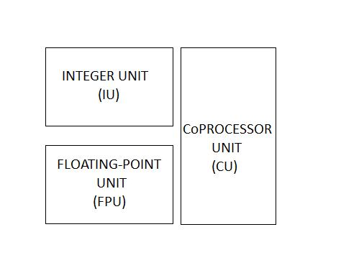
The Modules

Slide 8
The Integer Unit (IU)
Contains the general purpose registers and controls the overall operation of the processor.
may contain from 64 to 528 general-purpose 64-bit r registers. They are partitioned into 8 global registers, 8 alternate global registers, plus a circular stack of from 3 to 32 sets of 16 registers each, known as register windows.
Executes the integer arithmetic instructions and computes memory addresses for loads and stores.
Maintains the program counters and controls instruction execution for the FPU.

Slide 9
The Register Window
At any time, an instruction can access the 8 global registers and a 24-register window
A register window comprises a 16-register set- divided into 8 in and 8 local registers- together with the 8 in registers of an adjacent register set, addressable from the current window as its out registers.
When a procedure is called, the register window shifts by sixteen registers, hiding the old input registers and old local registers and making the old output registers the new input registers.
Input registers : arguments are passed to a function
Local registers : to store any local data.
Output registers : When calling a function, the programmer puts his argument in these registers.

Slide 10
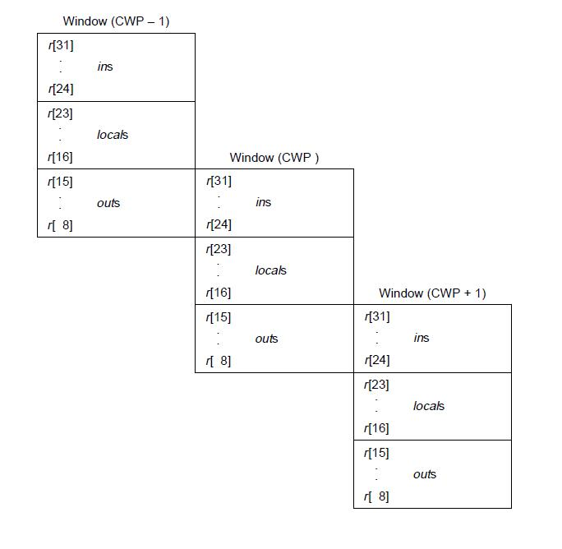
The Register Window
The current window into the r registers is given by the current window pointer (CWP) register.

Slide 11
The Floating-point Unit (FPU)
The FPU has 32 32-bit (single-precision) floating-point registers, 32 64-bit (double-precision) floating-point registers, and 16 128-bit (quad-precision) floating-point registers.
Double-precision values occupy an even-odd pair of single-precision registers.
Quad-precision values occupy an odd-even number pair of double precision registers.
Floating-point load/store instructions are used to move data between the FPU and memory.
The memory address is calculated by the IU.
Floating-Point operate (FPop) instructions perform the floating-point arithmetic operations and comparisons.

Slide 12
Coprocessor Unit (CU)
The instruction set includes support for a single, implementation-dependent coprocessor. The coprocessor has its own set of registers.
Coprocessor load/store instructions are used to move data between the coprocessor registers and memory.
floating-point instructions mirrors coprocessor instructions.
Not implemented in SPARC V9.

Slide 13
Instructions
Instructions can fall into following basic categories :
Load/store
Arithmetic/logical/shift
Control transfer
Read/write control register
Floating-point/Coprocessor operate

Slide 14
SPARC v9 features
64-bit Data and Addresses as compared to 32-bit Data and Addresses of SPARC V8.
32 double-precision floating-point registers,
Software-settable branch prediction
64-bit integer multiply and divide instructions
load/store floating-point quad word instructions
Branches on register value (eliminating the need to compare)
The V9 remains binary compatible with all previous SPARC architecture.

Slide 15
References
The SPARC Architecture Manual Version 8
The SPARC Architecture Manual Version 9
Cpu-collection.de
http://www.cpu-collection.de/?tn=1&l0=cl&l1=SPARC
http://en.wikipedia.org/wiki/SPARC
www.cmpe.boun.edu.tr
Ozan Aktan - SuperSPARC Architecture

Slide 16
THANK YOU

